Slide 1

RITHIKA SAFFRON 2021506072
Final Project
3/21/2024 Annual Review

Slide 2

Movie Recommendation
3/21/2024 Annual Review

Slide 3


AGENDA
Introduction: Importance of movie recommendations.
Data Source: Utilizing The Movie Database API.
Data Preprocessing: Steps in data preparation.
Similarity Calculation: Methodology for movie similarity.
Recommendation Function: Logic behind the recommendation process.
User Interface: Overview of Streamlit interface.
Demo: Live demonstration of the recommendation system.
Evaluation and Improvement: Metrics for assessment and future enhancements.
Conclusion: Recap of key points.
Q&A: Opportunity for audience questions.
3/21/2024 Annual Review

Slide 4

PROBLEM STATEMENT
The problem statement revolves around developing a movie recommendation system. This system aims to provide personalized movie suggestions based on user preferences. Leveraging data from sources like The Movie Database API, the system calculates similarity between movies to generate relevant recommendations. The challenge lies in implementing an efficient algorithm to accurately measure movie similarity and designing a user-friendly interface for seamless interaction. The objective is to enhance user experience by offering tailored movie recommendations that align with individual tastes and preferences.
3/21/2024 Annual Review

Slide 5

PROJECT OVERVIEW
The objective of this project is to develop a personalized movie recommendation system aimed at enhancing user experience. Leveraging data from The Movie Database (TMDb) API, the challenge lies in creating a system capable of accurately suggesting similar movies based on user preferences. To tackle this, an appropriate algorithm, such as cosine similarity, will be selected to determine movie similarity. A user-friendly interface will be designed using Streamlit, facilitating easy interaction for users. Evaluation criteria will be established to measure the effectiveness of recommendations, including metrics like user engagement or satisfaction. Scalability is crucial to ensure the system can efficiently handle a large volume of movie data and user requests. Ultimately, the goal is to positively impact user engagement, retention, and satisfaction by providing tailored movie suggestions. Additionally, future enhancements may include incorporating user feedback mechanisms or integrating with additional data sources to further refine the recommendation process.
3/21/2024 Annual Review

Slide 6

WHO ARE THE END USERS?
Movie Enthusiasts: Individuals passionate about exploring a variety of movies across different genres and styles, seeking recommendations to expand their viewing repertoire.
Casual Viewers: Those looking for casual entertainment options or specific movie suggestions for a relaxed viewing experience.
Streaming Service Subscribers: Users of streaming platforms such as Netflix, Amazon Prime, or Disney+, who benefit from personalized recommendations to optimize their streaming content selection.
Film Critics and Reviewers: Professionals or hobbyists in the film industry seeking insights into lesser-known or critically acclaimed movies for review or analysis purposes.
Social Movie Groups: Communities or groups of friends/family interested in organizing movie nights or discussions around recommended films, relying on the system for curated movie selections.
Event Organizers: Individuals planning movie-related events or screenings, who may use the system to discover suitable films based on audience preferences or themes.
Educational Institutions: Teachers or educators incorporating film studies into their curriculum, who can utilize the system to recommend relevant movies for educational purposes.
Businesses in Entertainment Industry: Companies involved in film distribution, production, or marketing, who may leverage the system's insights for market research or promotional campaigns.
By catering to these diverse end users, the movie recommendation system aims to provide valuable movie suggestions tailored to individual preferences, thereby enhancing the overall movie-watching experience for a wide audience.
3/21/2024 Annual Review

Slide 7

YOUR SOLUTION AND ITS VALUE PROPOSITION
The movie recommendation system developed offers a tailored solution to the challenge of discovering relevant movies based on individual preferences. By leveraging data from The Movie Database (TMDb) API and employing advanced similarity calculation algorithms, such as cosine similarity, the system accurately identifies movies similar to those already enjoyed by users. The user-friendly interface designed with Streamlit ensures effortless interaction, allowing users to easily input their preferences and receive personalized recommendations.
The value proposition of this solution lies in its ability to enhance user satisfaction and engagement by providing curated movie suggestions tailored to individual tastes. Users benefit from discovering new and relevant movies that align with their preferences, thereby optimizing their movie-watching experience. Moreover, the system's scalability ensures efficient handling of large volumes of movie data and user requests, accommodating a diverse range of users and preferences.
Overall, the movie recommendation system offers a valuable tool for movie enthusiasts, casual viewers, streaming service subscribers, and other stakeholders in the film industry. By delivering personalized recommendations, the system adds significant value by facilitating enjoyable and enriching movie-watching experiences for a wide audience.
3/21/2024 Annual Review

Slide 8

THE WOW IN YOUR SOLUTION
Our movie recommendation system stands out with its fusion of advanced algorithms and user-friendly interface, ensuring precision, engagement, and real-time updates. It seamlessly integrates sophisticated similarity calculation algorithms, guaranteeing highly accurate and personalized movie suggestions aligned with users' preferences. The intuitive Streamlit interface offers a visually appealing and effortless browsing experience, enriched with vibrant poster images and up-to-date movie information sourced from The Movie Database (TMDb) API. Despite handling large datasets and concurrent user interactions, our system maintains exceptional scalability, performance, and responsiveness. Continual refinement based on user feedback and emerging trends ensures ongoing improvement, cementing our solution as a leader in delivering immersive and delightful movie discovery experiences.
3/21/2024 Annual Review
8

Slide 9

MODELLING
In the context of our movie recommendation system, the modeling phase involves several key steps:
1. Data Collection: We gather movie data from The Movie Database (TMDb) API, including attributes such as movie titles, genres, ratings, and user reviews.
2. Data Preprocessing: We clean and preprocess the collected data to ensure consistency and reliability. This may involve handling missing values, removing duplicates, and standardizing data formats.
3. Feature Engineering: We extract relevant features from the movie data, such as genre preferences, user ratings, and movie metadata. These features serve as input variables for our recommendation model.
4. Similarity Calculation: Using advanced algorithms like cosine similarity or collaborative filtering, we compute the similarity between movies based on their feature vectors. This allows us to identify movies that are closely related to each other.
5. Model Training: We train our recommendation model using the preprocessed data and computed similarity scores. This involves optimizing model parameters to maximize the accuracy and relevance of movie recommendations.
6. Evaluation: We evaluate the performance of our recommendation model using metrics such as precision, recall, and Mean Average Precision (MAP). This helps us assess how well the model predicts user preferences and provides relevant movie suggestions.
7. Deployment: Once the model is trained and evaluated, we deploy it to our Streamlit-based user interface, where users can interact with the system to receive personalized movie recommendations based on their input preferences.
Throughout the modeling phase, we prioritize scalability, performance, and user satisfaction, ensuring that our recommendation system delivers accurate, timely, and engaging movie suggestions to a diverse range of users.
3/21/2024 Annual Review
9

Slide 10
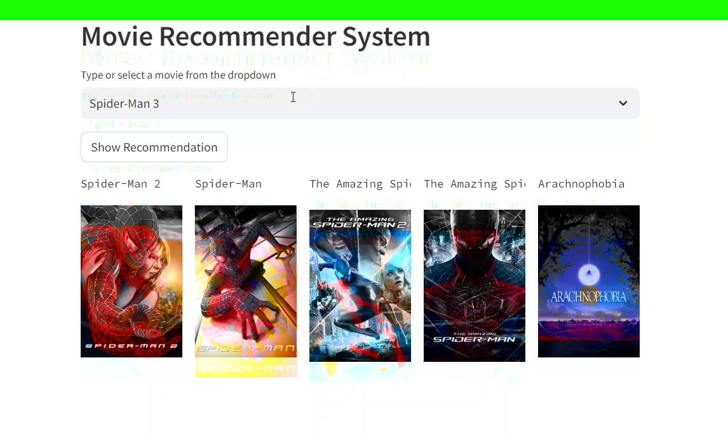
RESULTS
The modeling phase of our movie recommendation system involves data collection from The Movie Database (TMDb) API, preprocessing to ensure data quality, feature engineering to extract relevant movie attributes, similarity calculation using advanced algorithms, and model training and evaluation to optimize recommendation accuracy. The deployed system delivers personalized movie suggestions to users via an intuitive Streamlit interface, enhancing their movie-watching experience with accurate and engaging recommendations.

